Slide 1
Get your implementation study
Predictive technology

Slide 2
HDSN carries out your implementation study free of charge based on the data you send us.
This study is essential to determine the number and location of sensors in your equipment. It will also serve as specifications for the operator who will carry out the installation? whether it's your teams or a subcontractor.
Thank you for passing our certification course which will allow you to understand in 10 minutes which installations can be protected and how.

Slide 3
METRICS TO SHARE WITH US
https://youtu.be/YVXTdwCdPX0

Slide 4
The plans of the cabinets
Plans with cabinet dimensions

Slide 5
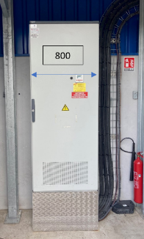
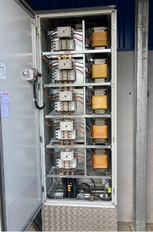
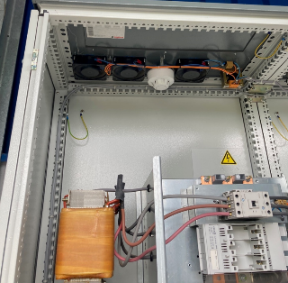
Photos of the cabinets
3 photos per cell Closed cabinet (whole), Open cabinet (if possible) Cabinet Top (Inside or Out:
need to see if the top is waterproof)

Slide 6
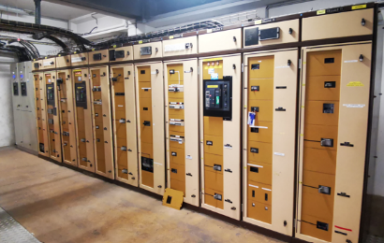
The local
An overview of the rooms where the cabinets are

Slide 7
The supervision system to be connected
The E-PREDICT alarm is triggered by a dry contact. How do you plan to deal with alarms? -flash -Buzzer - on the cabinet or in the room - MODBUS TCP/IP upload to GTC - Automated reassembly - entry into the TLS - Need a dedicated HMI?

Slide 8
STUDY AND COSTING
→ Sending data by email to BE@HDSN.FR
the HDSN Design Office will provide you with a (free of charge) implementation study and our sales department will send you a quote

Slide 9
SAVE TIME
https://youtu.be/YVXTdwCdPX0

Slide 10
Train yourself in 10 minutes
Pass your certification course in 10 minutes You will save time to size your study correctly:
www.hdsn.fr → Compliance & Services → Certification course
Or click on the image here→
Good luck!

Slide 11
Predictive
100% end to end HDSN
Global patent, international certification
« Intervene well before a fire starts, up to two weeks before the incident. A revolution for the prevention of electrical fire risk. »
www.socotec.fr

Slide 12
Universal
100% Reliable Local and wired
100% Autonomous Zero cloud, no radio (Cyber CEM)
100% Compatible Universal

Slide 13
We protect them

Slide 14
WWW.HDSN.FR

